Slide 1


Evacuating Urban Areas with Electrified Transportation Systems (EVacuate)
Presented by:
Dan Molzahn (ECE), PI
Sam Coogan (ECE/CEE), Co-PI
Pascal Van Hentenryck (ISyE), Co-PI
June 8, 2021
EPICenter Vehicle-Grid Summer Research Symposium
Atlanta, GA

Slide 2
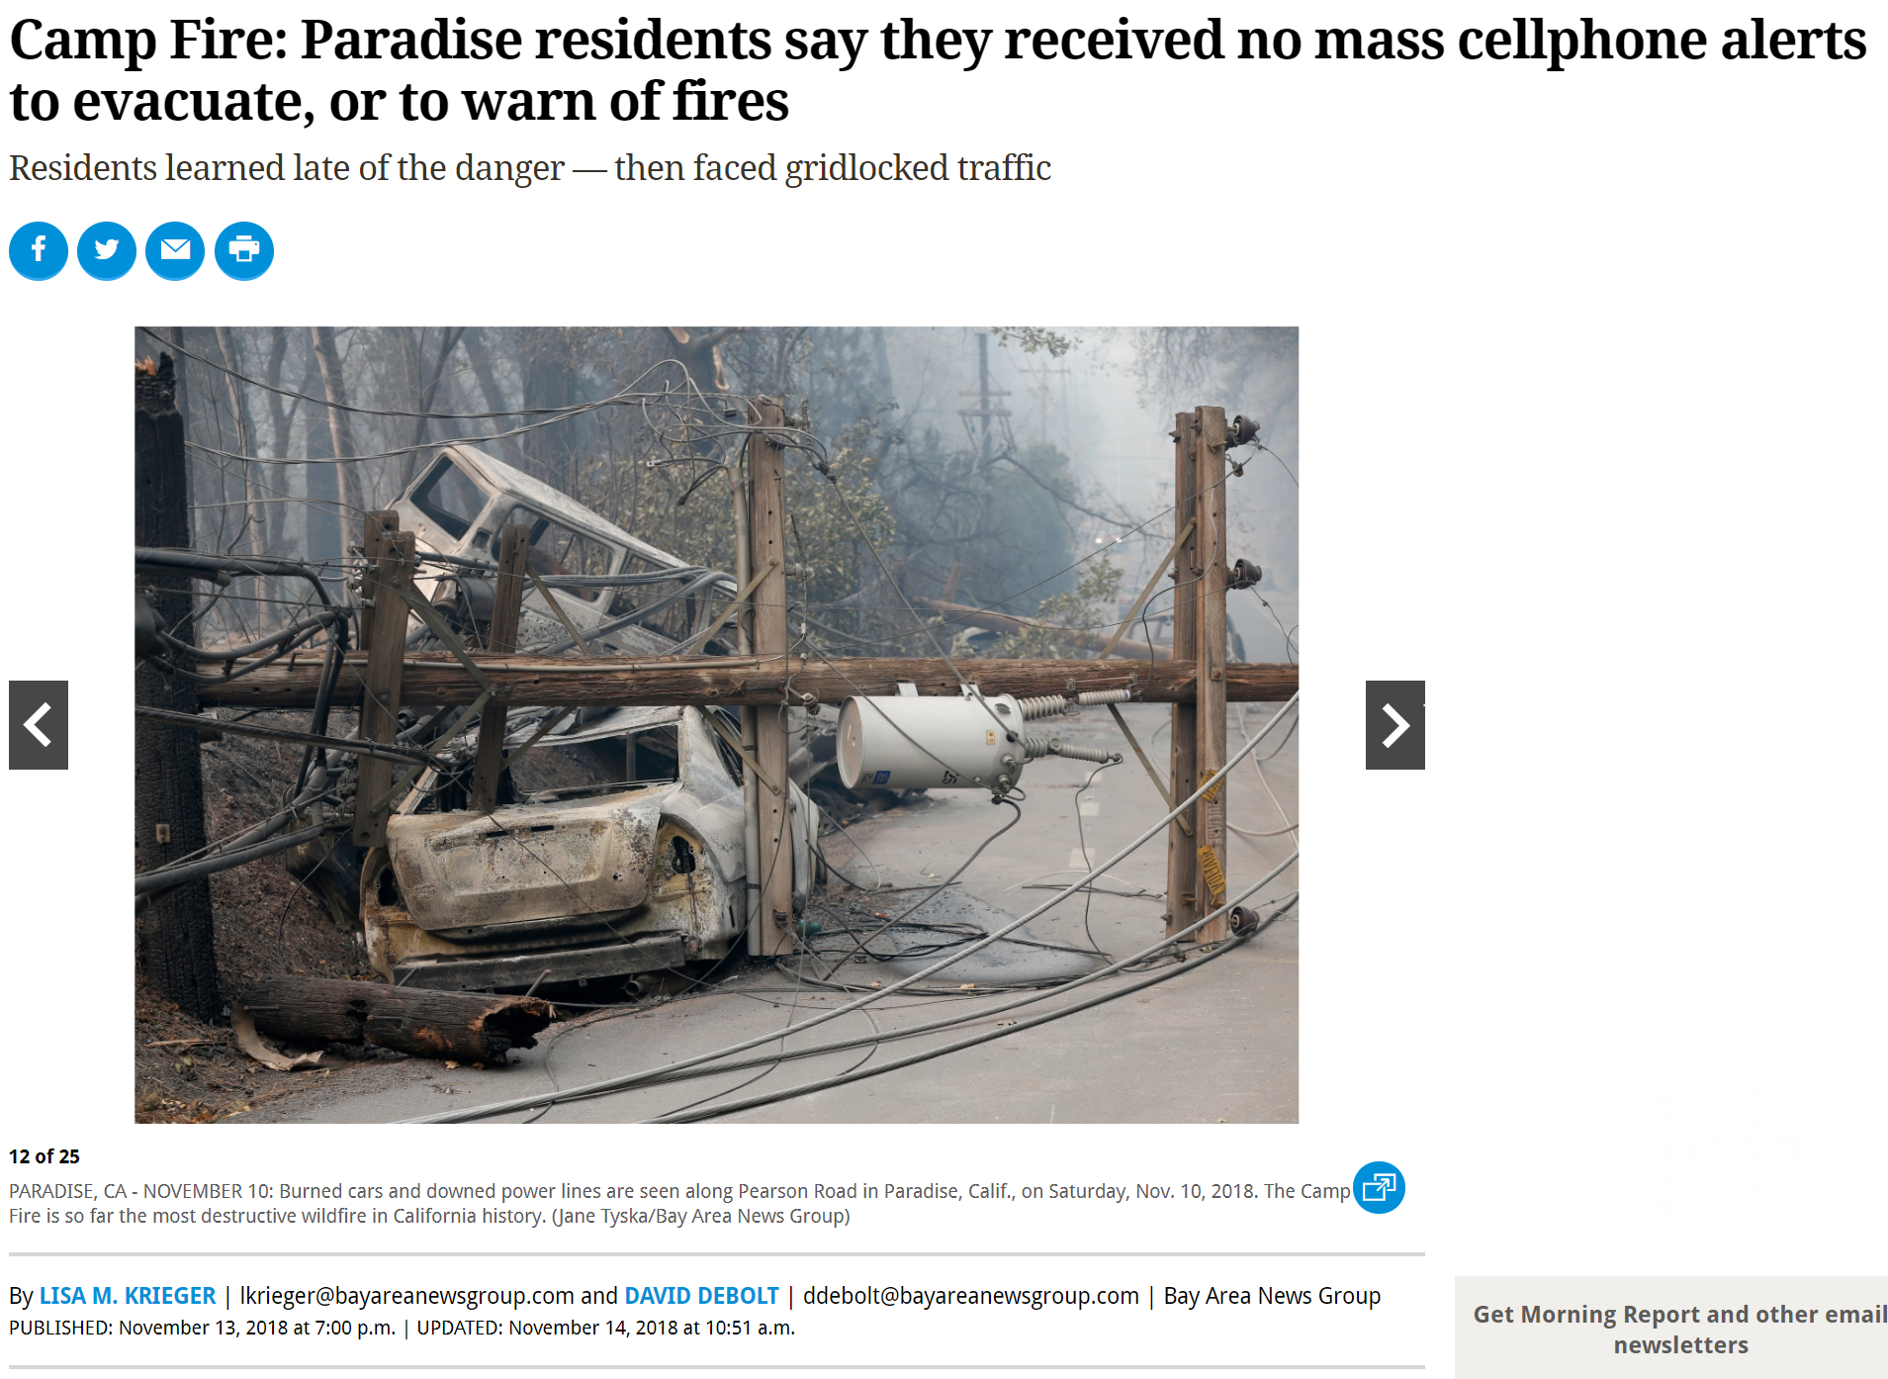

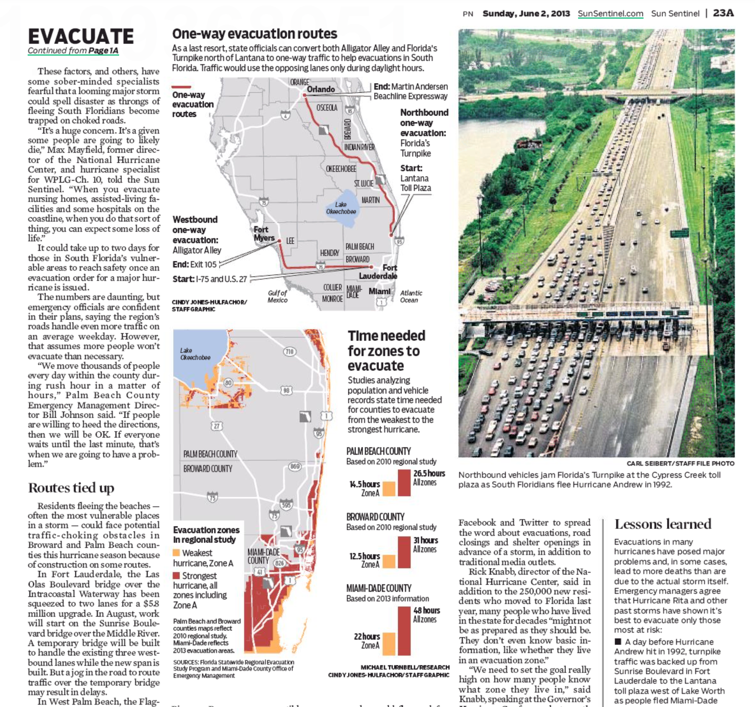
Background and Motivation
Increasingly severe disasters motivate better evacuation planning

Slide 3
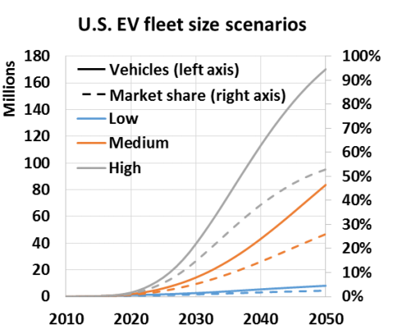
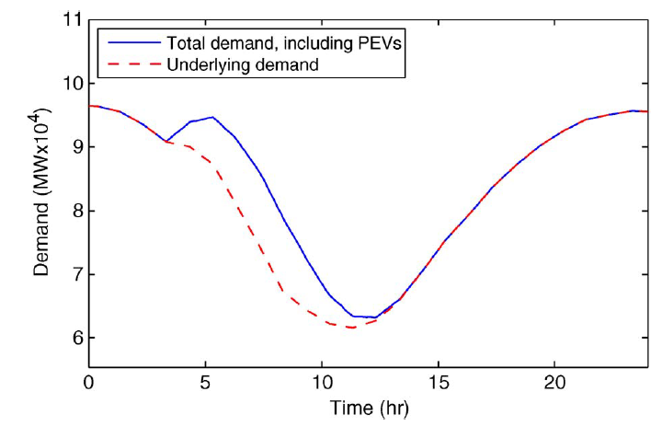
Background and Motivation
The rapid adoption of electric vehicles (EVs) imposes new challenges
Line and Transformer Overloads
Percent Overload:
> 300%
250 – 300%
200 – 250%
150 – 200%
100 – 150%
Low
Medium
High
EV Adoption
[Callaway & Hiskens ‘11]
Electric Power Research Institute (EPRI) projections for EV adoption
EV charging during evacuations can significantly overload electric systems
Existing EV charging coordination algorithms are not applicable for evacuations
Need new approaches for coordinating EV charging during evacuations to avoid overloading electric distribution systems!

Slide 4










Research Team
Electric Power
Transportation
Evacuation Planning
Daniel Molzahn
Assistant Professor
School of Electrical and Computer Engineering
Sam Coogan
Assistant Professor
School of Electrical and Computer Engineering
Demetrius T. Paris Junior Professor
School of Civil and Environmental Engineering
Gustav Nilsson
Postdoctoral Scholar
School of Electrical and Computer Engineering
Pascal Van Hentenryck
A. Russell Chandler III Chair and Professor
Socially Aware Mobility (SAM) Lab
School of Industrial and Systems Engineering
Alejandro Owen Aquino
Ph.D. student
School of Electrical and Computer Engineering
Katelyn Iles
M.S. student
School of Civil and Environmental Engineering
Jorge Huertas
Ph.D. student
Socially Aware Mobility (SAM) Lab
School of Industrial and Systems Engineering

Slide 5
Research Question
How to optimally evacuate urban areas with electrified transportation systems?
Electric Power
Transportation
High-level model for evacuation planning
Detailed model for validation
High-level model for evacuation planning
Detailed model for validation
Evacuation Planning
Validation
Validation
max (number of vehicles evacuated)
Constraints
constrained by high-level power grid model
high-level transportation model
Constraints

Slide 6

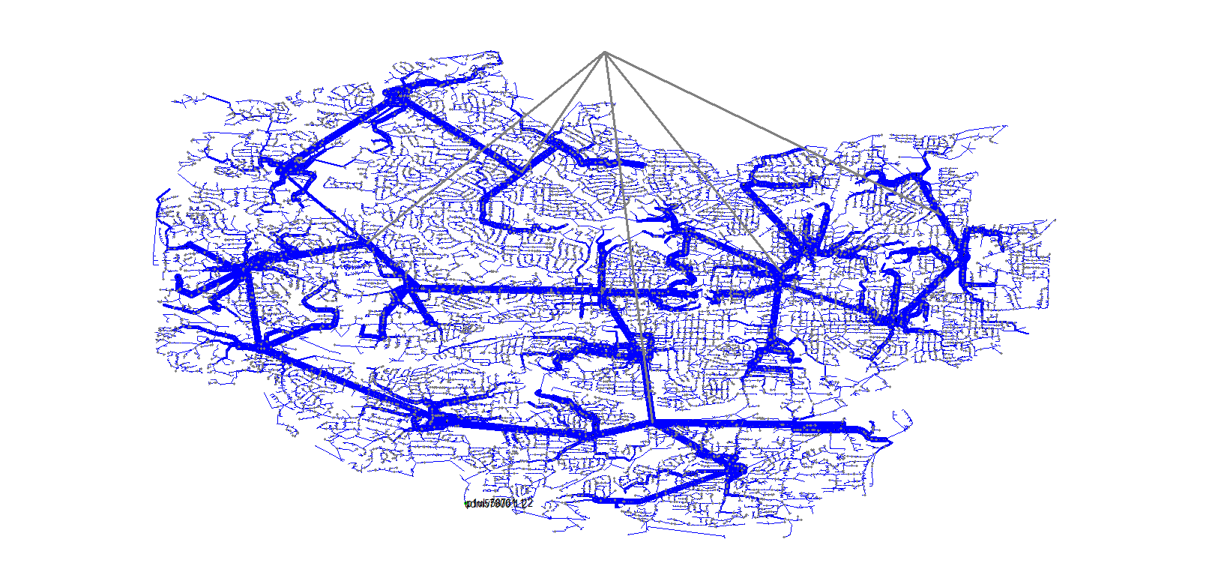

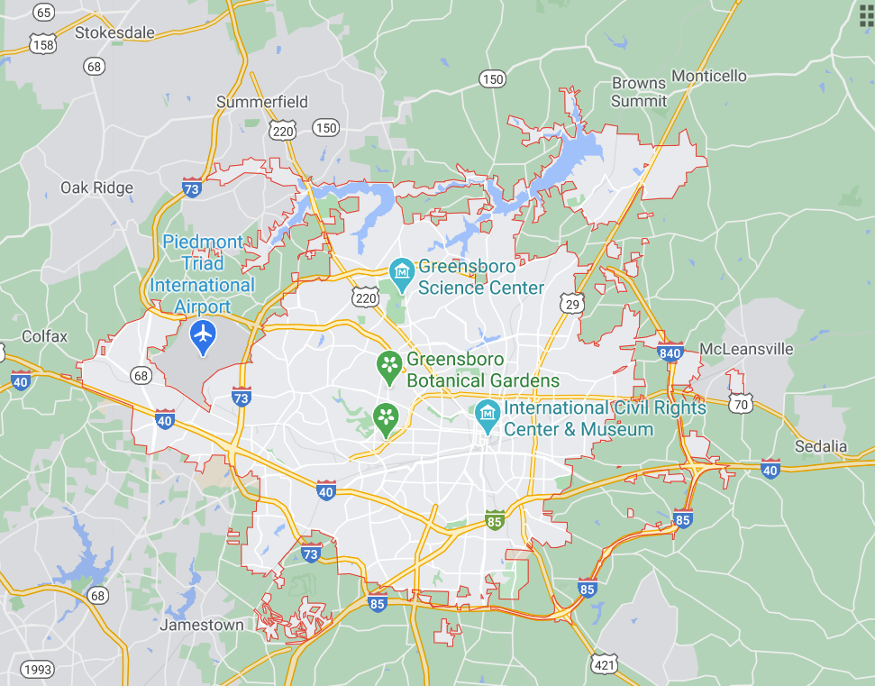
Test Case: Greensboro, NC
Why Greensboro?
NREL’s SMART-DS project provides publicly available, detailed “realistic but not real” electric distribution system datasets for Greensboro

Slide 7
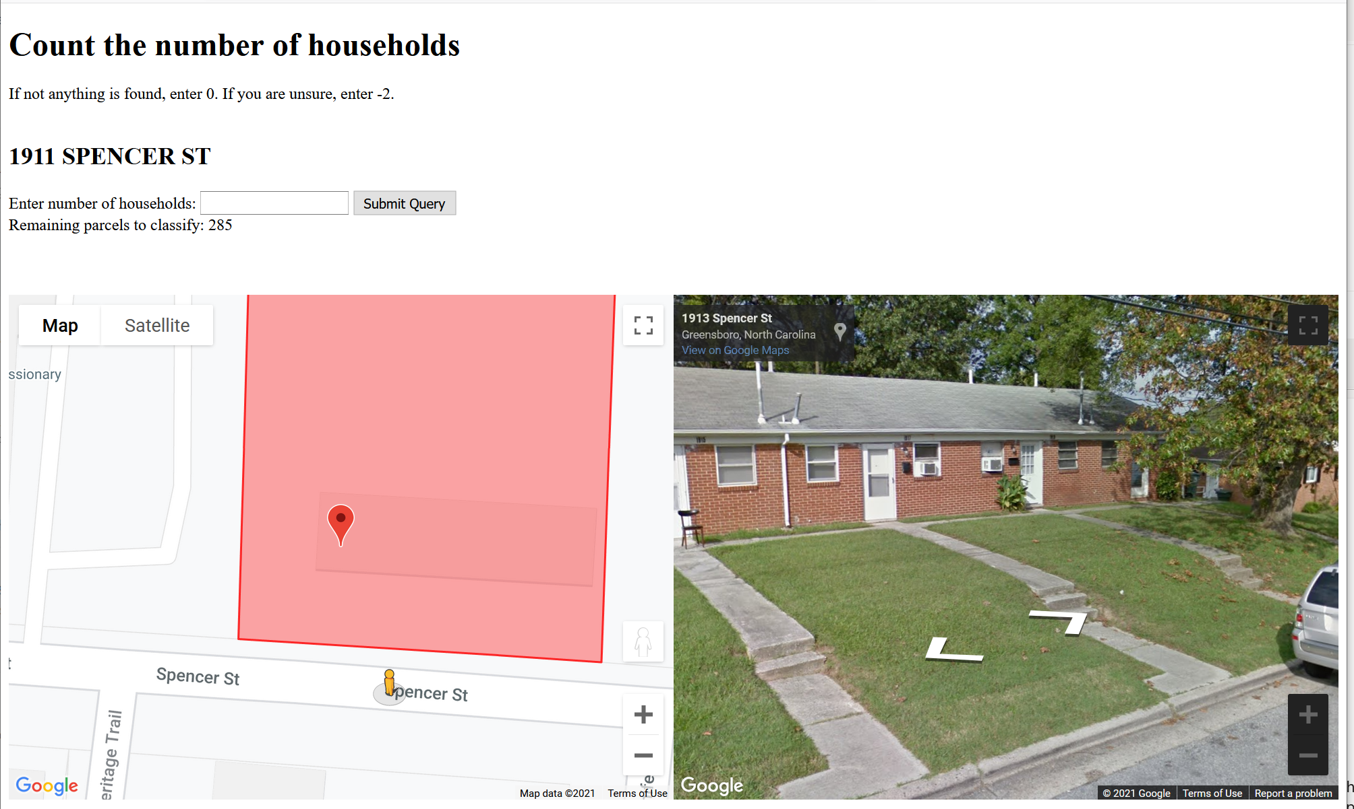


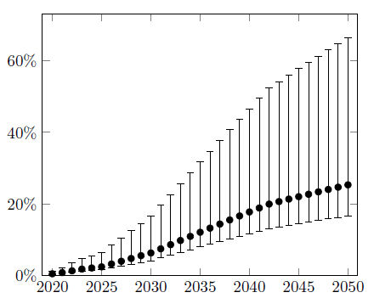
Electric Grid Model
EV locations from census data and manual entry from Google Street View
Detailed simulations via PowerModelsDistribution.jl and OpenDSS
Scenarios for EV adoption rates
Range of EV Adoption in Each Zone
High-level constraints for evacuation planning problem (in progress)

Slide 8
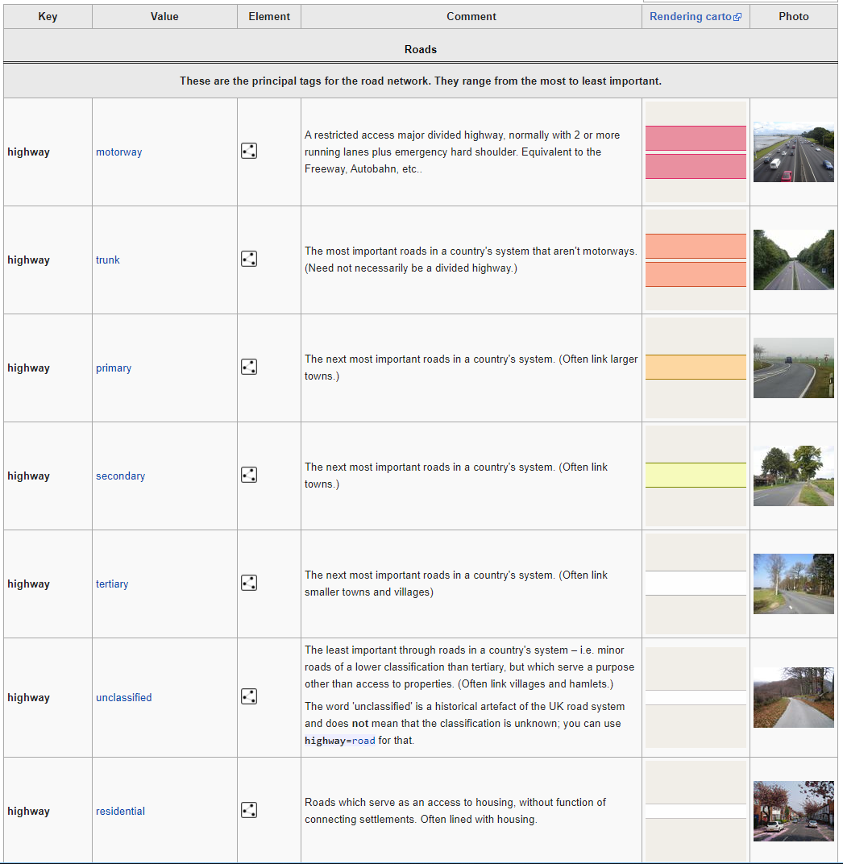
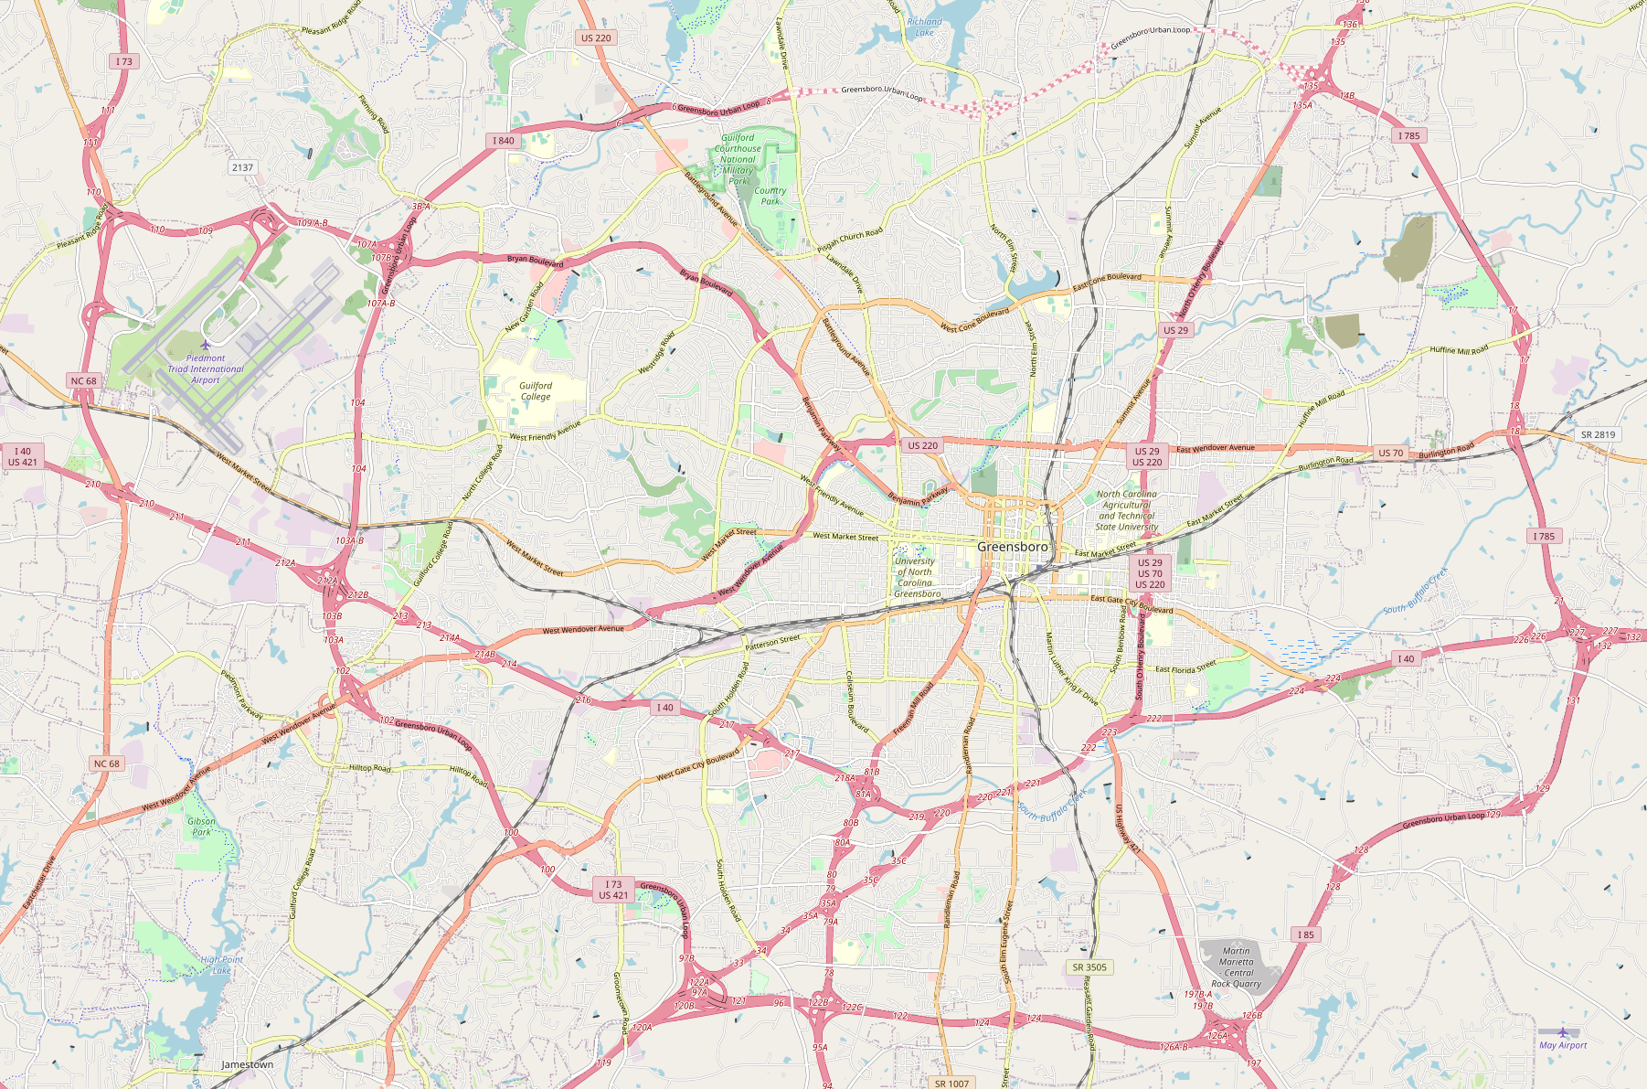
Transportation System Model
Data from OpenStreetMap

Slide 9
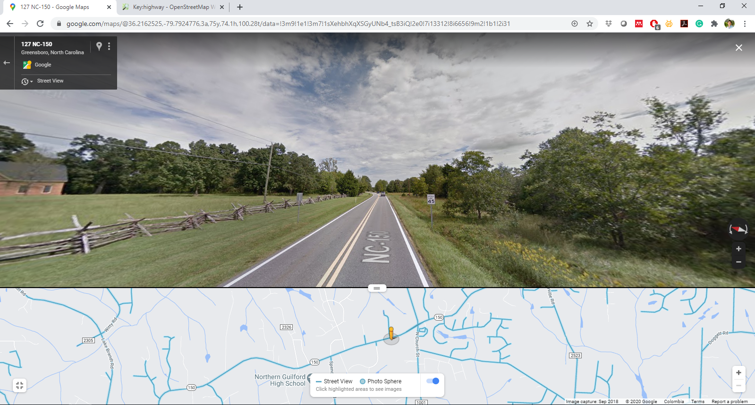
Transportation System Model
Handling missing data

Slide 10
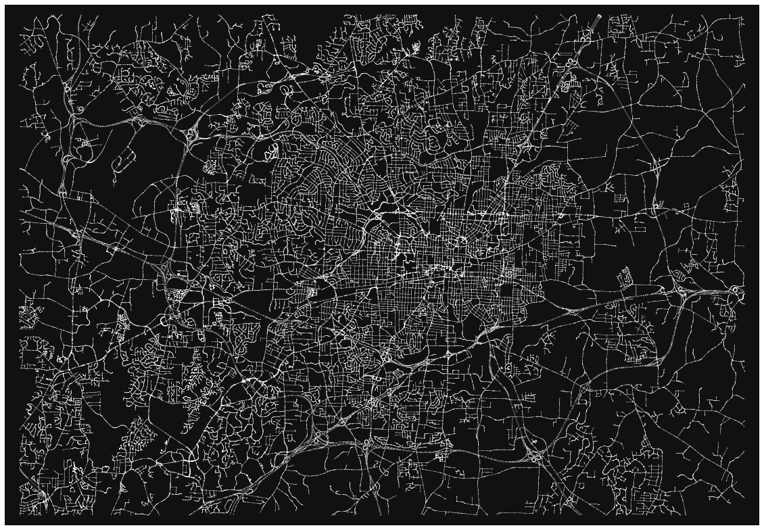
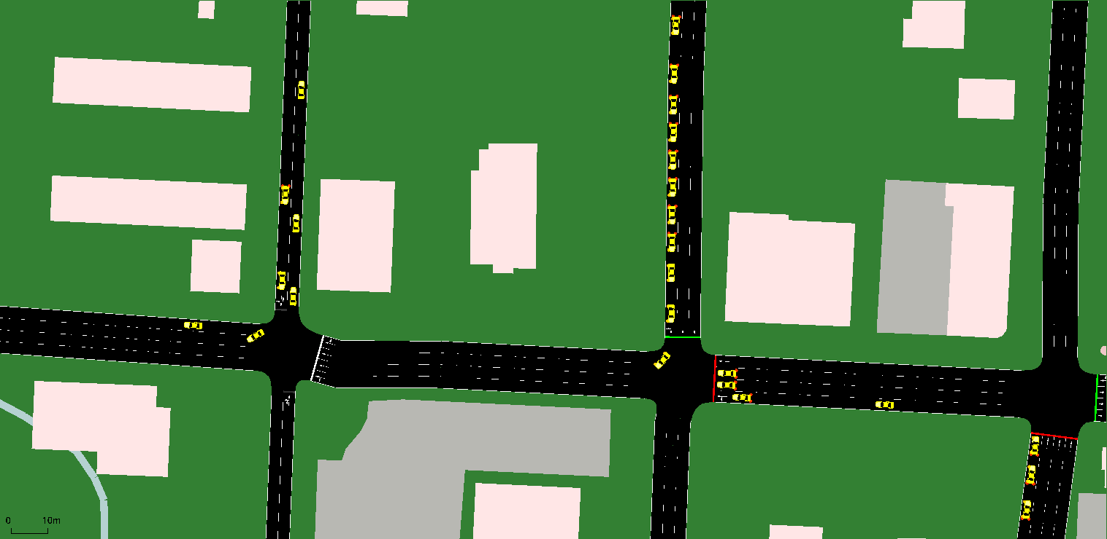

Transportation System Model
All roads
Too detailed for the evacuation planning problem!
Nodes: 91,815
Edges: 173,711
Input to the SUMO traffic simulator to provide a detailed transportation model for validation of the evacuation plans

Slide 11
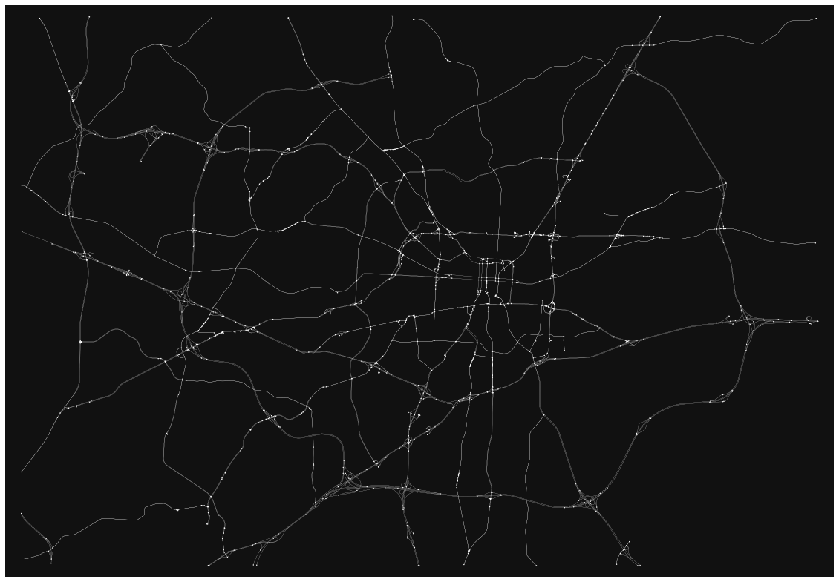
Transportation System Model
Simplified model
Motorway
Trunk
Primary
Secondary
Models of intersections are still too detailed.
Nodes: 1,486
Edges: 2,793

Slide 12
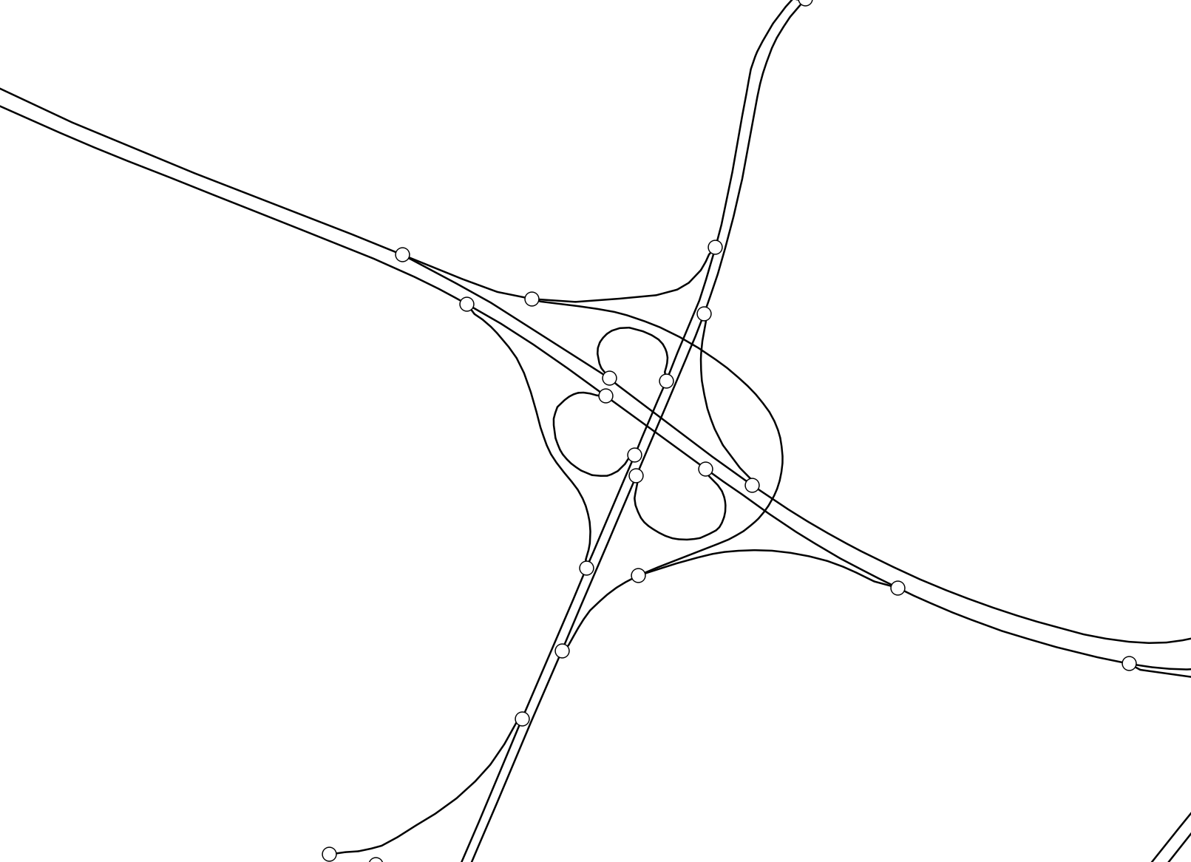
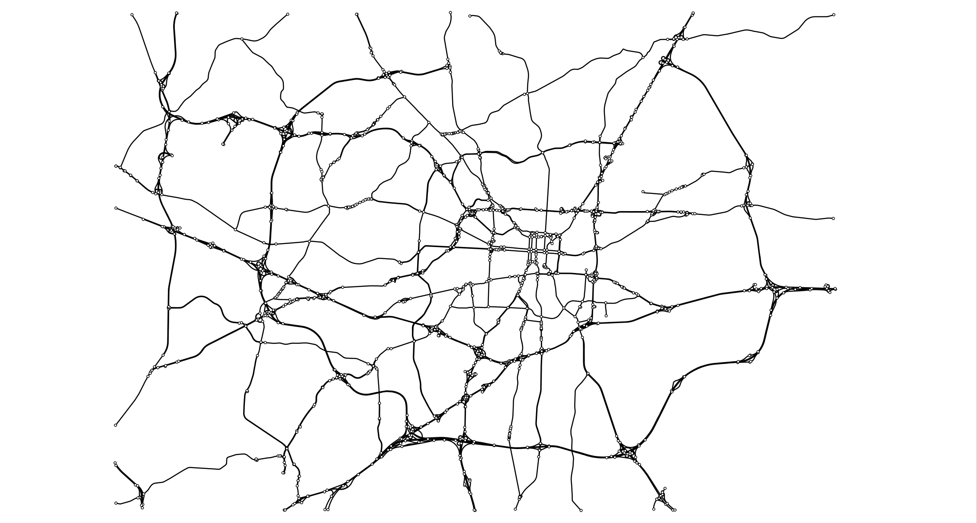
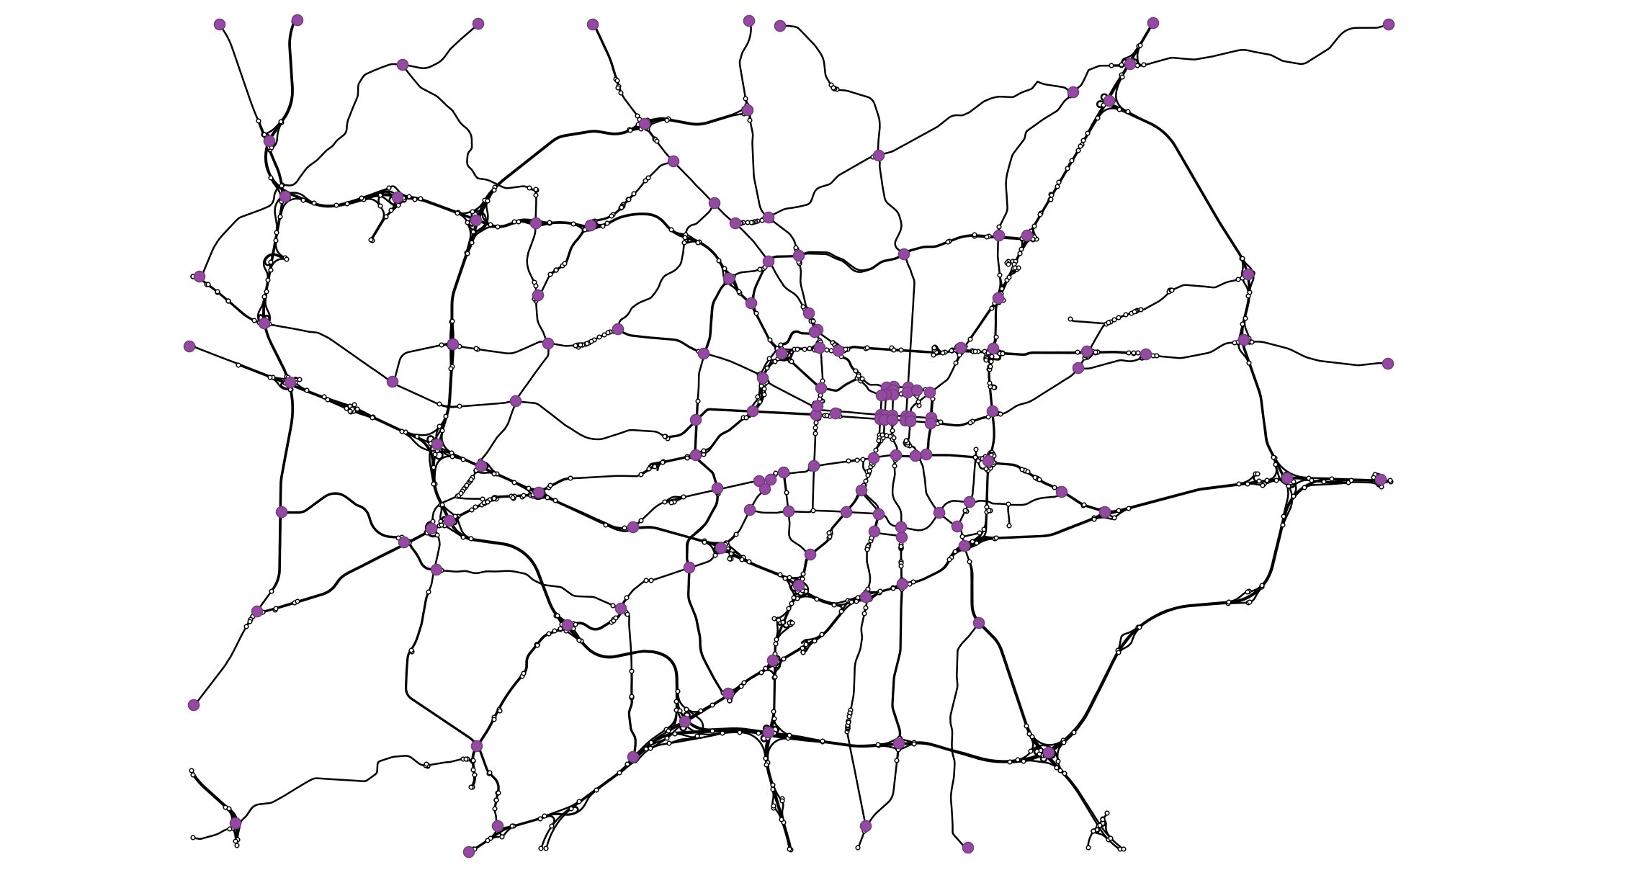
Transportation System Model
Nodes: 1,486 → 149
Appropriate level of detail for computing evacuation plans
How to decide which nodes to aggregate?
Manual visual inspection.

Slide 13
Electric Grid and Transportation Models
To the best of our knowledge, this is the first dataset coupling large-scale, high-fidelity transportation and electric system models for various EV adoption scenarios.

Slide 14
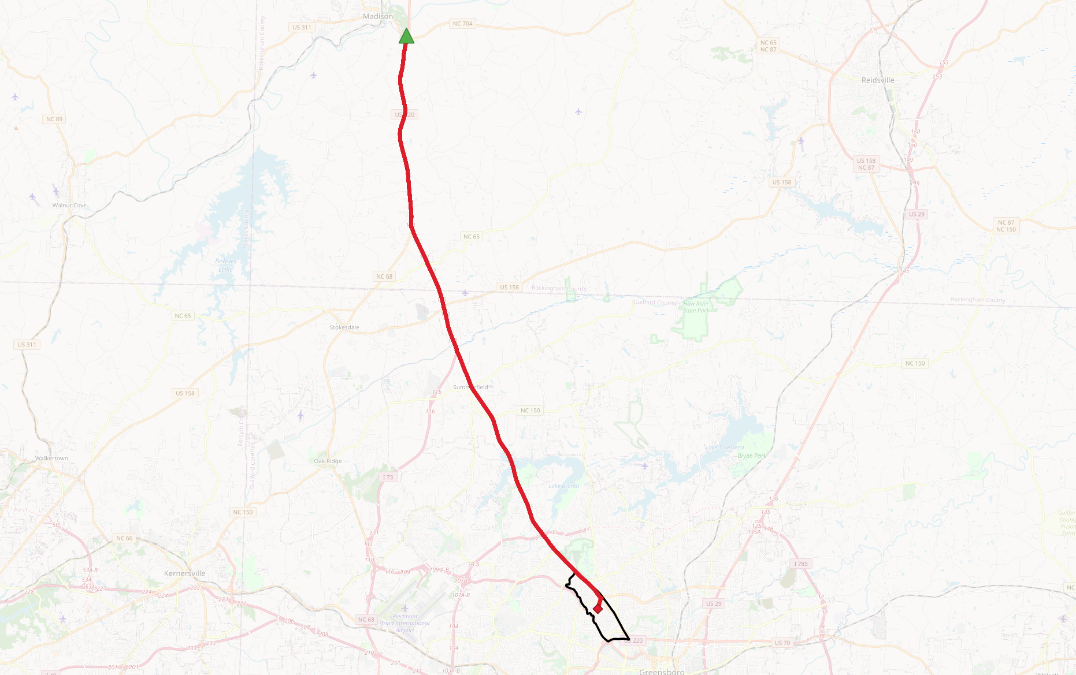
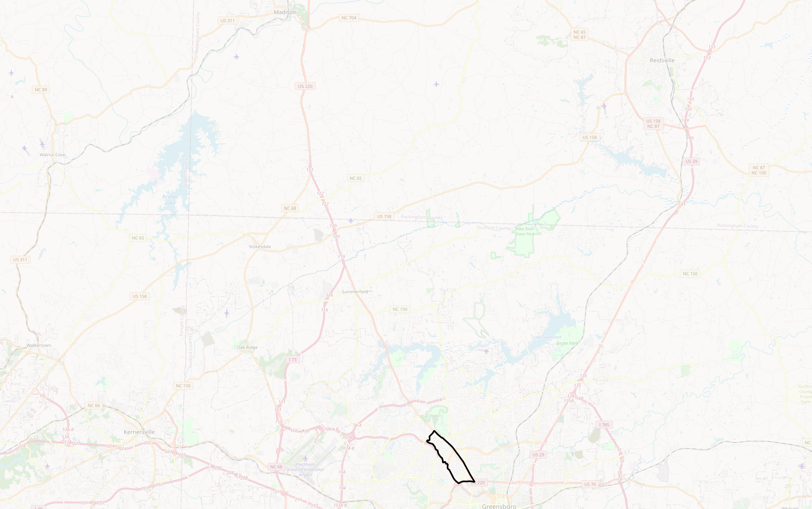
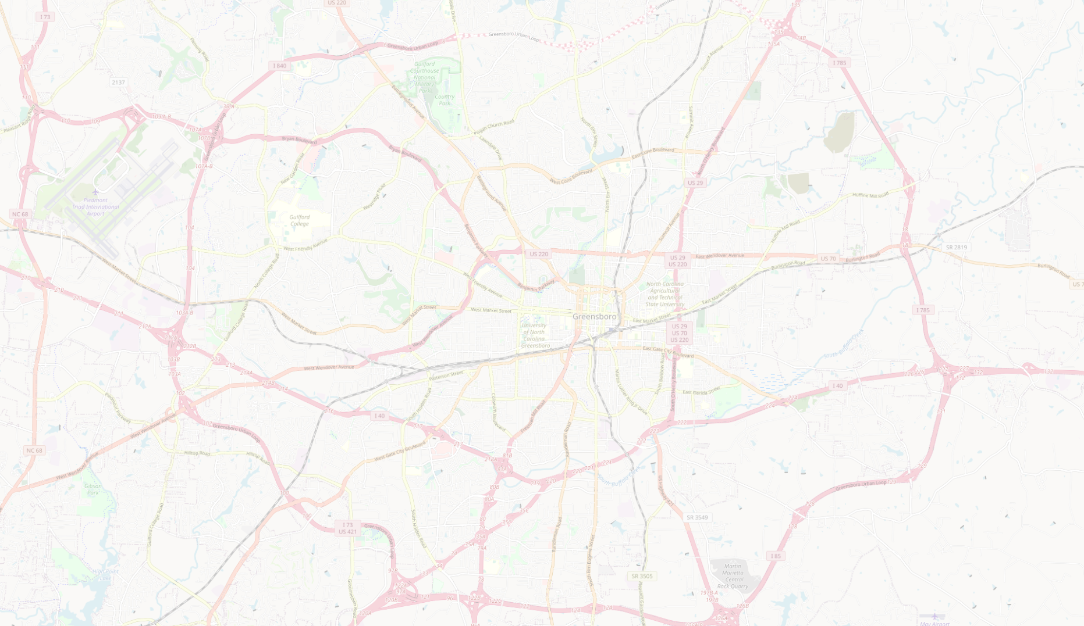
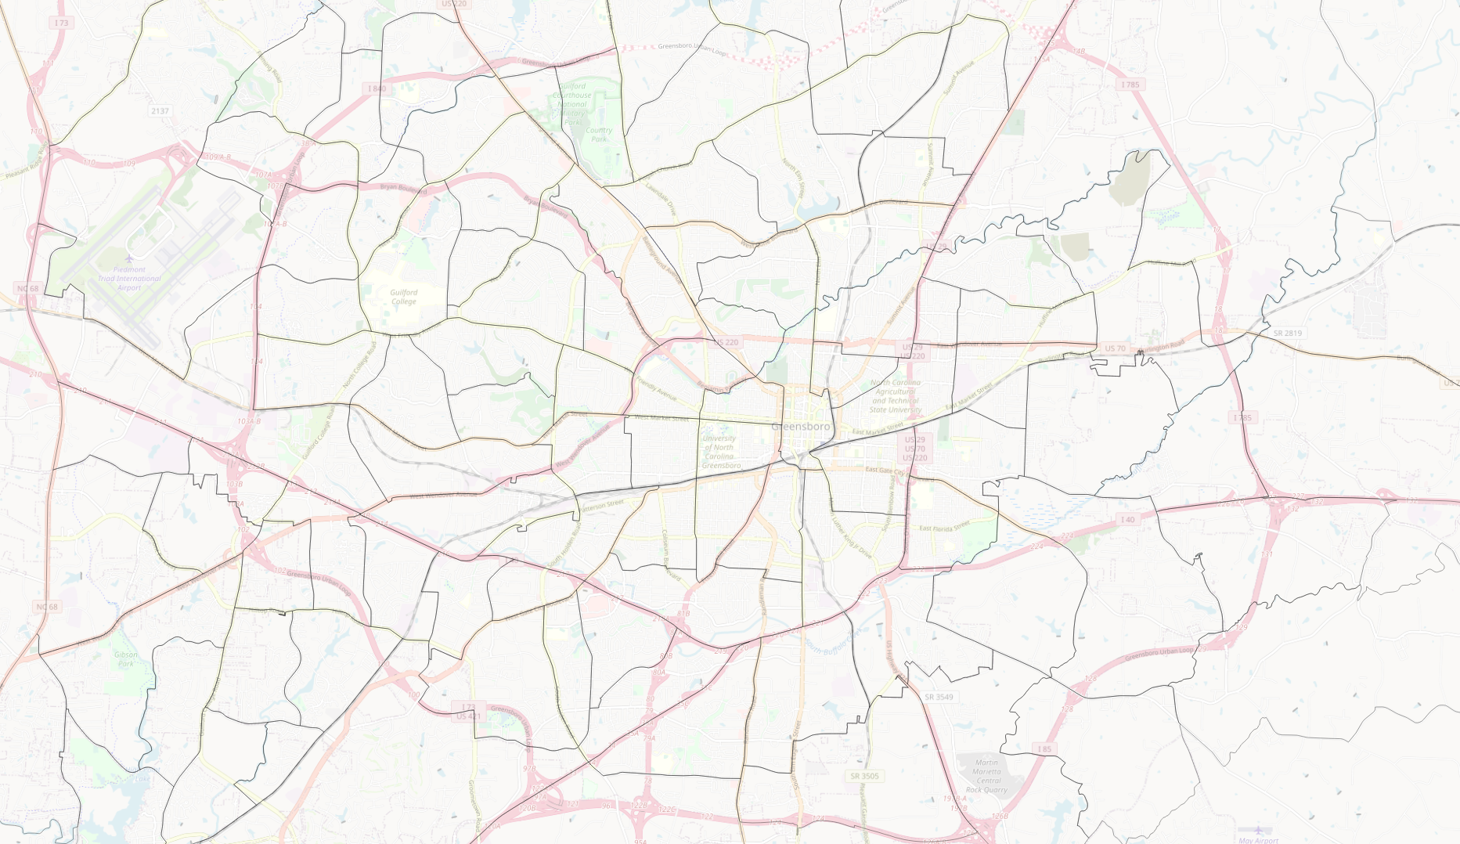



Evacuation Planning
How do emergency managers plan evacuations?
Divide the region into zones
For every zone
Evacuation route
Schedule

Slide 15
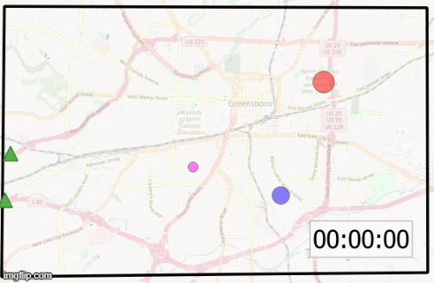
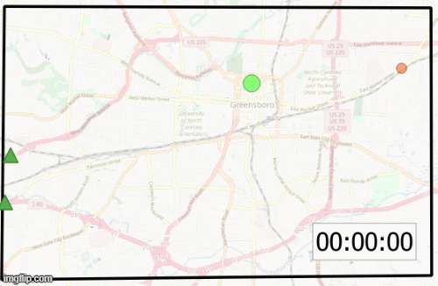
Evacuation Planning
Two key desired characteristics of an evacuation plan:
Convergent
Non-preemptive
Existing algorithms provide one or the other, but not both characteristics
[Even et al. ’15], [Pillac, Cebrain et al. ’15], [Romanski & Van Hentenryck ’16], [Hasan & Van Hentenryck ‘17, ‘20a, ‘20b]

Slide 16
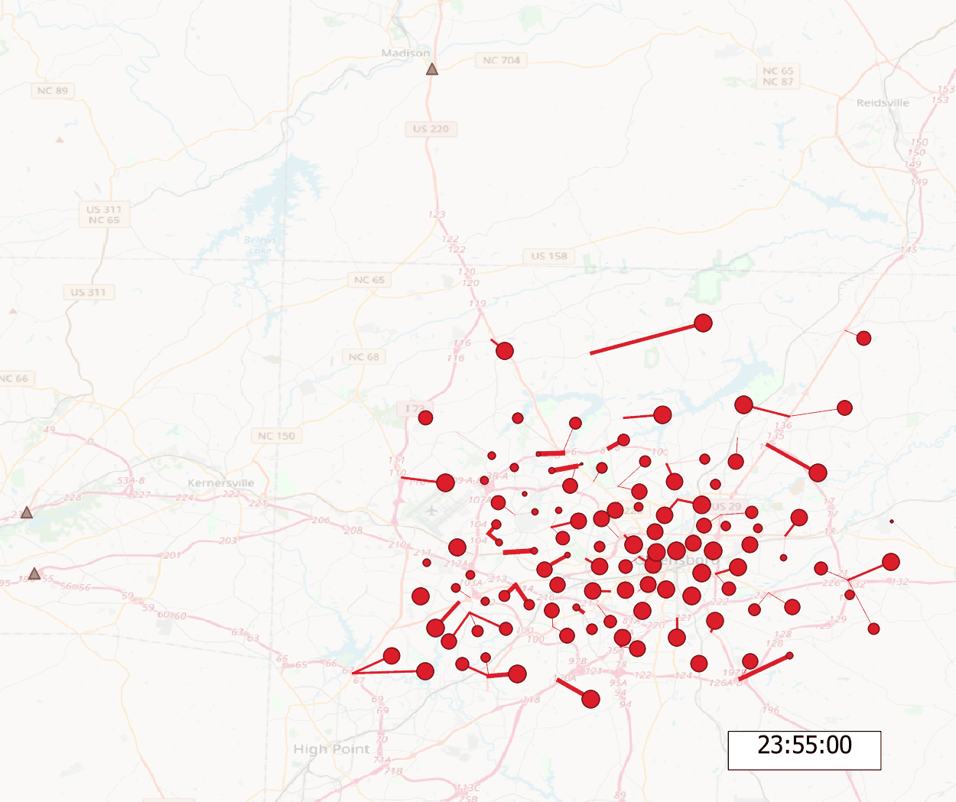
Evacuation Planning
We have advanced the state of the art to efficiently compute simultaneously convergent AND non-preemptive evacuation plans

Slide 17
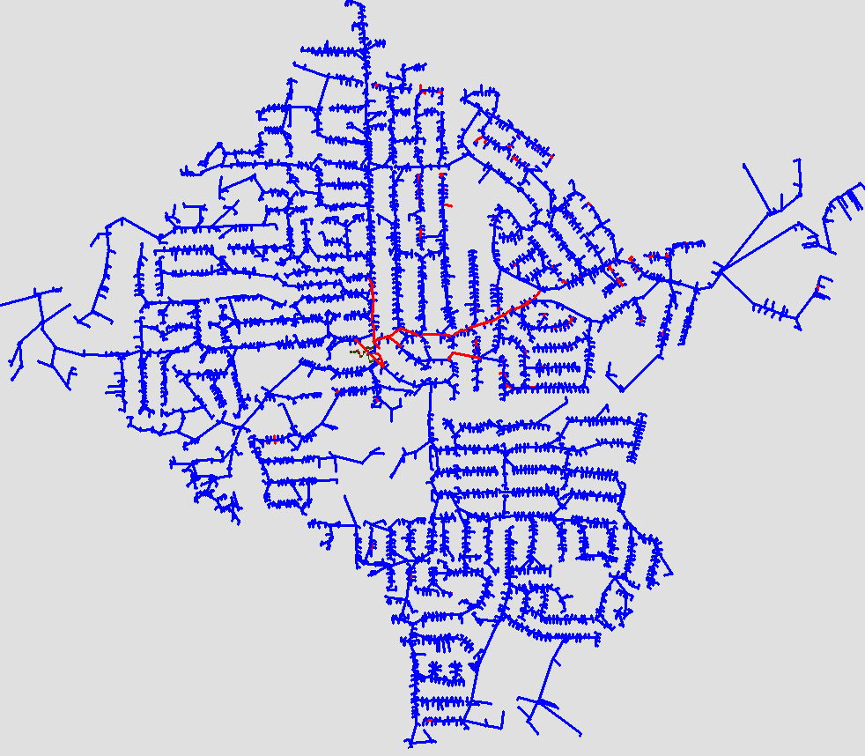
Bringing It All Together
Initial results:
Evacuations that neglect electric grid constraints lead to overloads
Evacuations that completely neglect detailed transportation system dynamics lead to traffic congestion
Line and Transformer Overloads
Percent Overload:
> 300%
250 – 300%
200 – 250%
150 – 200%
100 – 150%
EV Adoption
Low (25%)
Medium (55%)
High (80%)

Slide 18
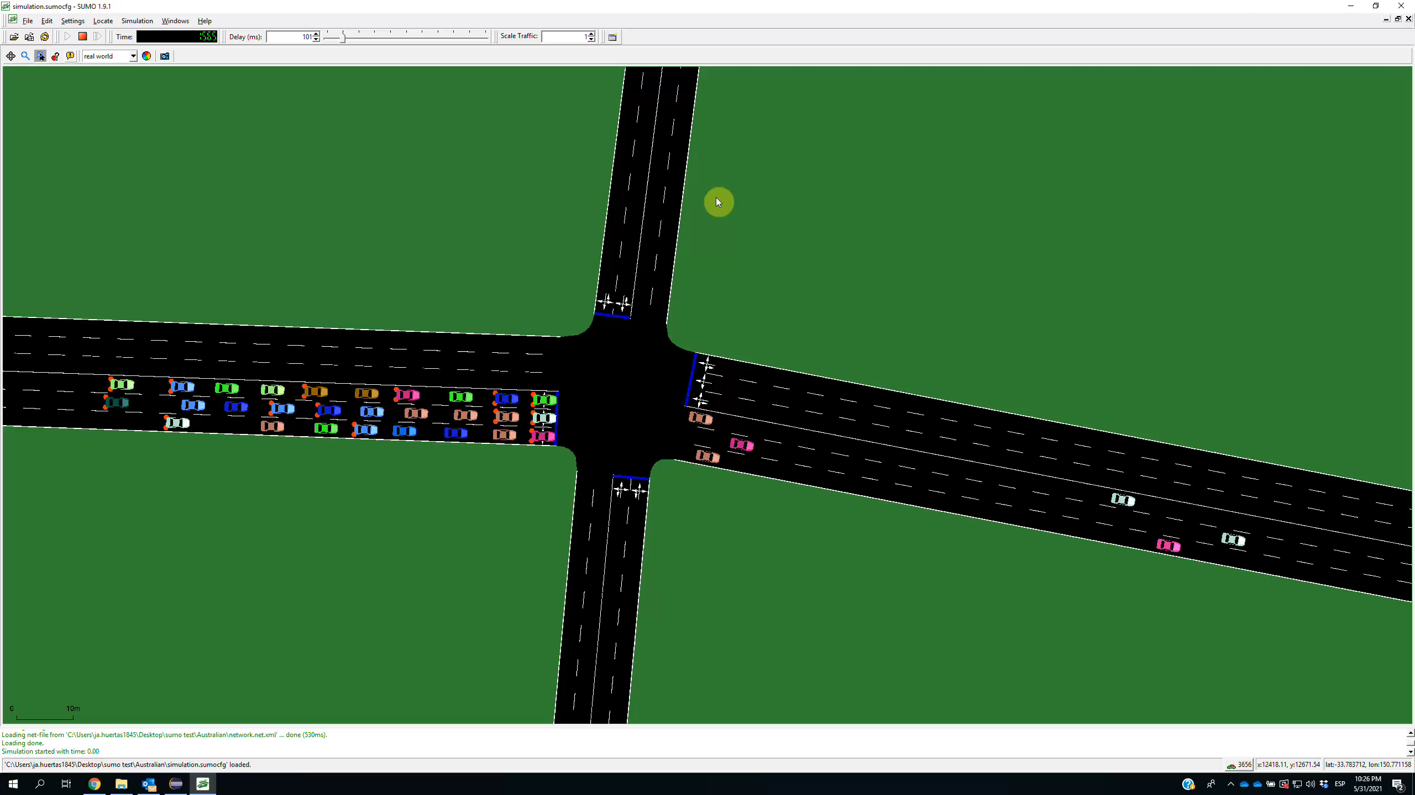
Bringing It All Together
Initial results:
Evacuations that neglect electric grid constraints lead to overloads
Evacuations that completely neglect detailed transportation system dynamics lead to traffic congestion

Slide 19
Bringing It All Together
Initial results:
Evacuations that neglect electric grid constraints lead to overloads
Evacuations that completely neglect detailed transportation system dynamics lead to traffic congestion
Next steps:
Augmenting the evacuation planning problem with
Electric grid constraints
More detailed transportation constraints (intra- and inter-zone dynamics)
NSF proposal (Cyber-Physical Systems): Scalability, Robustness to uncertainty, Ability to inform infrastructure investments and repairs

Slide 20
Questions?
Dan Molzahn
molzahn@gatech.edu
Sam Coogan
sam.coogan@gatech.edu
Pascal Van Hentenryck
pascal.vanhentenryck@isye.gatech.edu

Slide 21
References
D.S. Callaway and I.A. Hiskens, “Achieving Controllability of Electric Loads,” Proceedings of the IEEE, vol. 99, no. 1, pp. 184-199, Jan. 2011.
C. Even, V. Pillac, and P. Van Hentenryck, “Convergent Plans for Large-Scale Evacuations,” AAAI’15: Proceedings of the Twenty-Ninth AAAI Conference on Artificial Intelligence, pp. 1121–1127, 2015.
D.M. Fobes, S. Claeys, F. Geth, and C. Coffrin, “PowerModelsDistribution.jl: An Open-Source Framework for Exploring Distribution Power Flow Formulations,” Electric Power Systems Research, vol. 189, 106664, Dec. 2020.
M.H. Hasan and P. Van Hentenryck, “A Column-Generation Algorithm for Evacuation Planning with Elementary Paths,” Principles and Practice of Constraint Programming (CP), Lecture Notes in Computer Science, vol. 10416. Springer, Cham., 2017.
M.H. Hasan and P. Van Hentenryck, “Large‐Scale Zone‐Based Evacuation Planning—Part I: Models and Algorithms,” Networks, vol. 77, pp. 127–145, 2021.
M.H. Hasan and P. Van Hentenryck, “Large‐Scale Zone‐Based Evacuation Planning, Part II: Macroscopic and Microscopic Evaluations,” Networks, vol. 77, pp. 341– 358, 2021.
V. Pillac, M. Cebrian, and P. Van Hentenryck, “A Column-Generation Approach for Joint Mobilization and Evacuation Planning,” Constraints, vol. 20 no. 3, pp. 285–303, 2015.
J. Romanski and P. Van Hentenryck, “Benders Decomposition for Large-Scale Prescriptive Evacuations,” AAAI'16: Proceedings of the Thirtieth AAAI Conference on Artificial Intelligence, pp. 3894–3900, Feb. 2016.

